Slide 1
Inversion of Control & IOC Containers

Slide 2
What is Dependency Inversion
Concept made popular by Robert Martin’s SOLID principles
Abstractions should be defined by a contract, not by an implementation
Interfaces, Abstract Classes
Code Contracts can define invariants, pre-conditions & post-conditions
Objects that use the abstraction, should only know about the contract, not the implementation
Remove the “new” keyword

Slide 3
Tightly Coupled to an Implementation
public class OrderService
{
public void ProcessOrder(Order order)
{
var orderRepository = new OrderRepository();
}
}
Tightly Coupled
Notes:
Not a problem until things get complicated

Slide 4
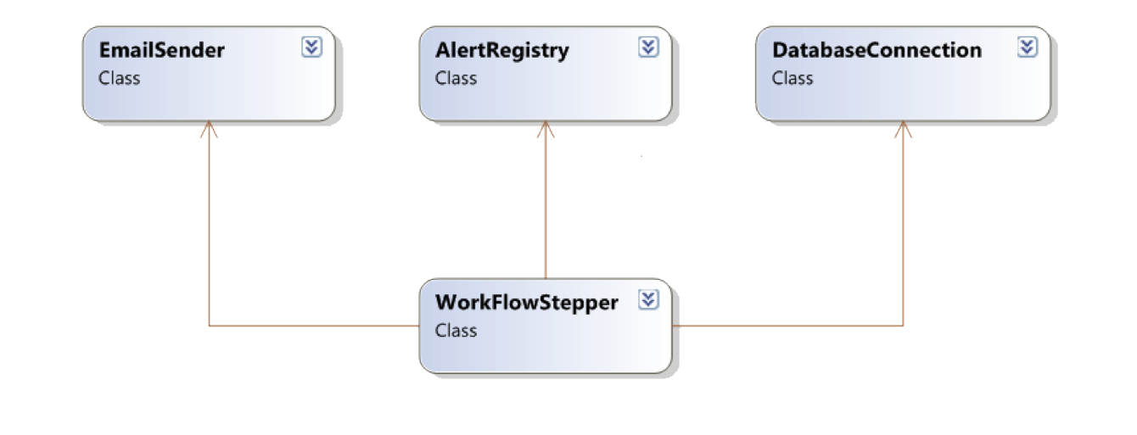

Slide 5
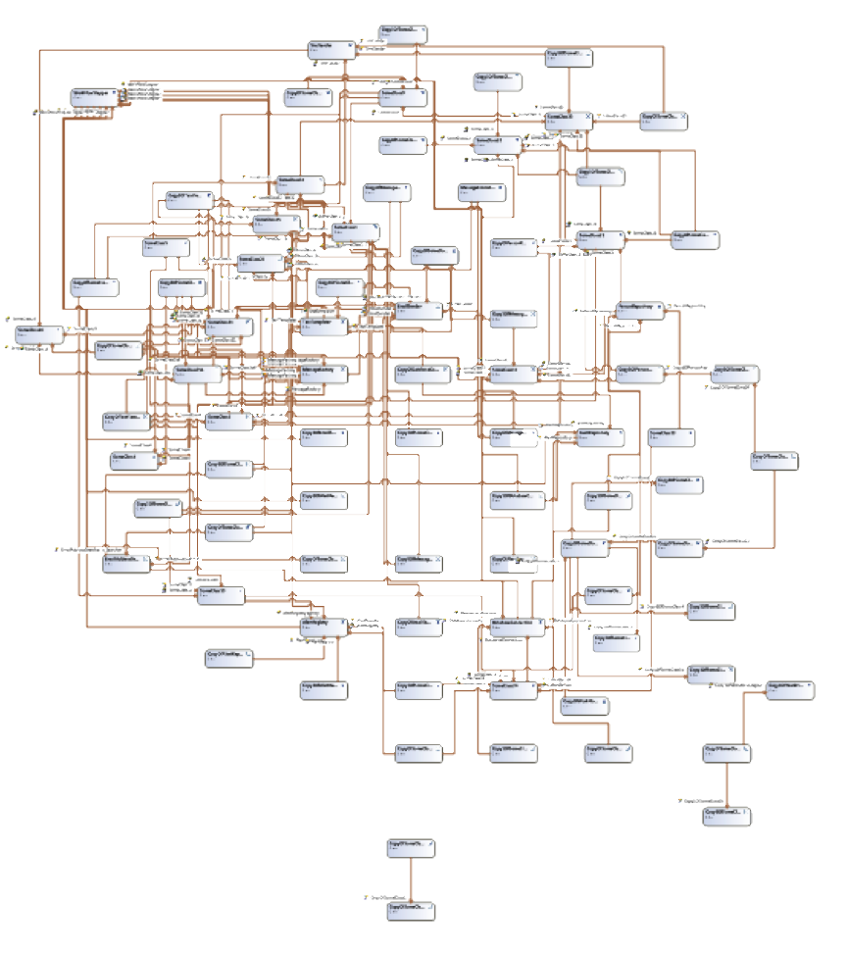
Notes:
Now it’s getting serious

Slide 6
Breaking the Implementation Coupling
Use an abstraction
Pass Implementation in as a Constructor Argument
Most stable approach
Set Implementation
Useful when you don’t have control over instantiation
Dependency Injection
More Brittle, harder to test
John Teague Avenida Software http://johnteague.lostechies.come

Slide 7
Constructor Injection
public class OrderService
{
private readonly INotificationService orderRepository;
public OrderService(INotificationService notificationService)
{
this.notificationService = notificationService;
}
public void ProcessOrder(Order order)
{
notificationService.SendNotice(order.Customer);
}
}
//using the service
var service = new OrderService(new EmailNotification());
John Teague Avenida Software http://johnteague.lostechies.come

Slide 8
Setter Injection
public class OrderService
{
private readonly INotificationService orderRepository;
public INotificationService NotificationService{get;set;}
public void ProcessOrder(Order order)
{
NotificationService.SendNotice(order.Customer);
}
}
//using the service
var service = new OrderService();
service.NotificationService = new EmailNotification();
John Teague Avenida Software http://johnteague.lostechies.come

Slide 9
Service Location
public class OrderService
{
public void ProcessOrder(Order order)
{
var orderRepository = ServiceLocator.Get<IOrderRepository>()
}
}

Slide 10
Poor Man’s DI
Use two Constructors
public class OrderService
{
private readonly INotificationService orderRepository;
public OrderService():base(new NotificationService()){}
public OrderService(INotificationService notificationService)
{
this.notificationService = notificationService;
}
public void ProcessOrder(Order order)
{
notificationService.SendNotice(order.Customer);
}
}
//using the service
var service = new OrderService(new EmailNotification());
John Teague Avenida Software http://johnteague.lostechies.come

Slide 11
Your Own Service Locator
Factory Object
Reflection Based Locator
public class OrderServiceFactory
{
public static IOrderService Create()
{
return new OrderService(new OrderRepository());
}
}
var orderService = OrderServiceFactory.Create
John Teague Avenida Software http://johnteague.lostechies.come

Slide 12
Problems with rolling your own
Starts simple gets very complicated
Advanced Generic Handing Difficult
Reinventing the wheel

Slide 13
IOC Containers
Abstracts the knowledge on how to build up complicated objects
Stores construction info to improve speed
Can manage Object Lifecycle
Instance
Per Thread
Thread Static
Http Context
Application Singleton
John Teague Avenida Software http://johnteague.lostechies.come

Slide 14
Modern IOC Container features
Allow Convention based configuration
Configuration through a dsl or xml
Allow for AOP techniques (Interception)
Manage object life cycle
“Profile” based configuration
John Teague Avenida Software http://johnteague.lostechies.com

